Slide 1








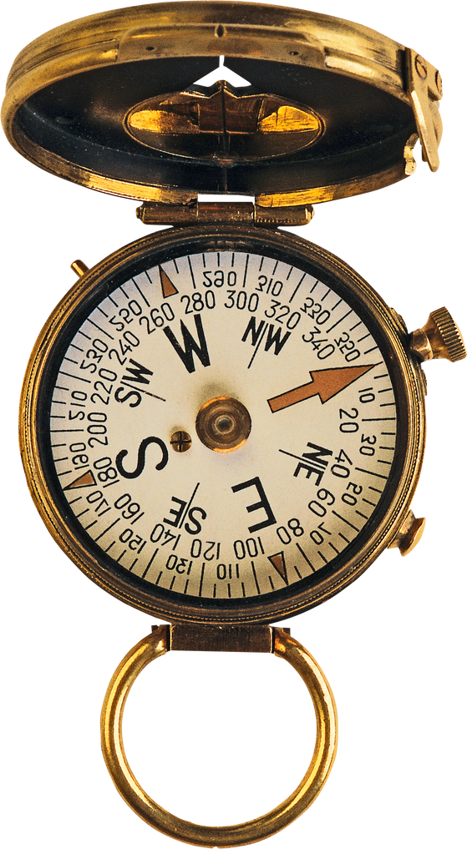




Bing Map API

Slide 2



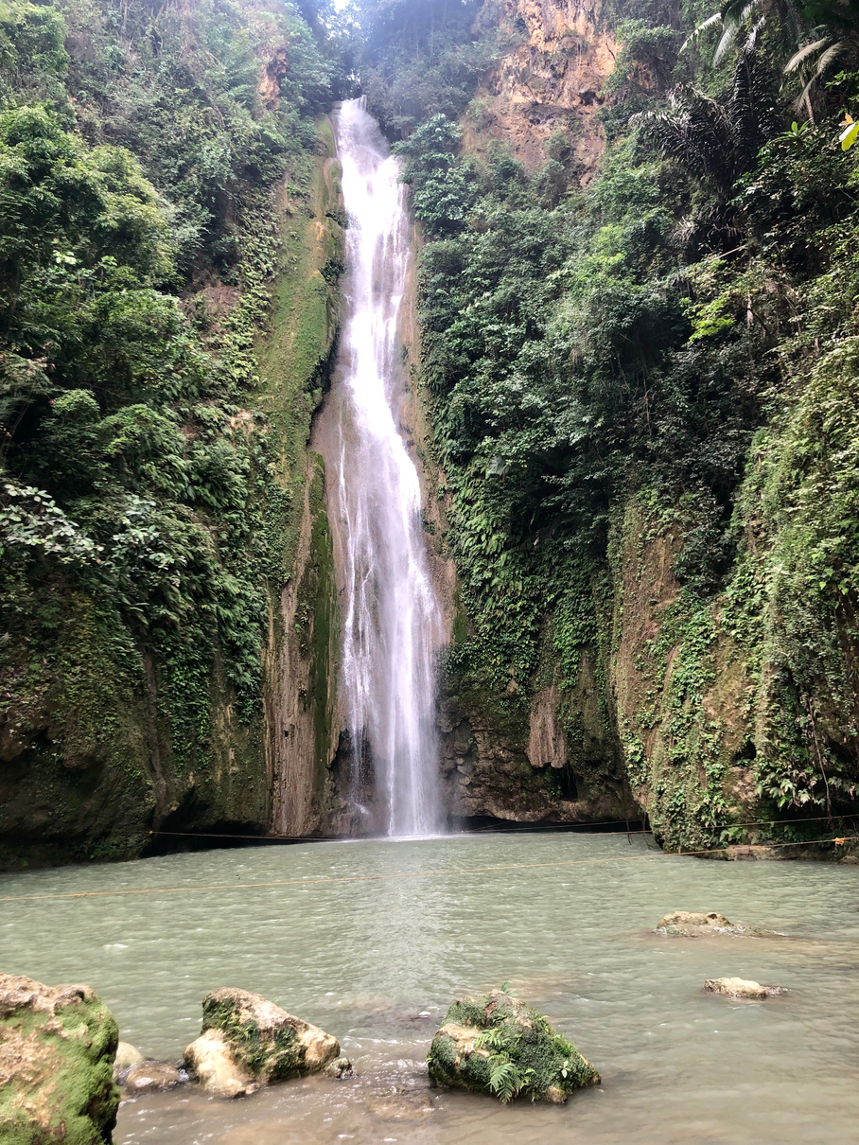

Project Tasks
Utilize the Bing Maps API
Ability to search or see restaurants and/or other POIs in the area
Ability to filter the search or view based on a polygon/area
Ability to see directions to a POI
Also see estimated travel times
Ability to log a visit to a POI

Slide 3








What is api?
API is the acronym for Application Programming Interface, which is a software intermediary that allows two applications to talk to each other. Each time you use an app like Facebook, send an instant message, or check the weather on your phone, you’re using an API

Slide 4

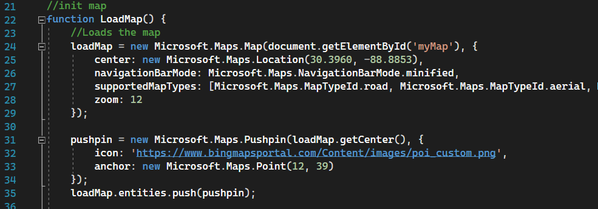
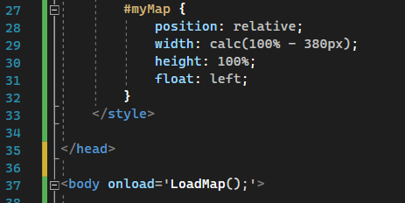
Loading the map

Slide 5

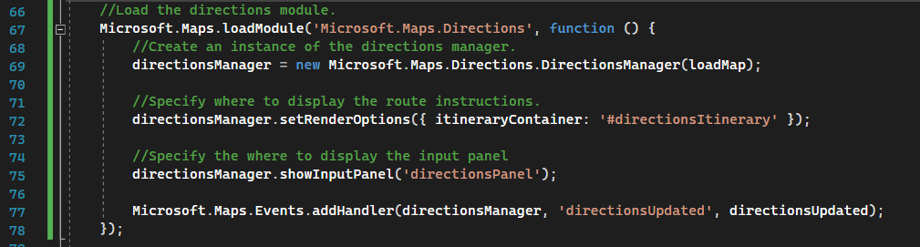
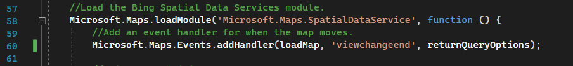
Modules

Slide 6


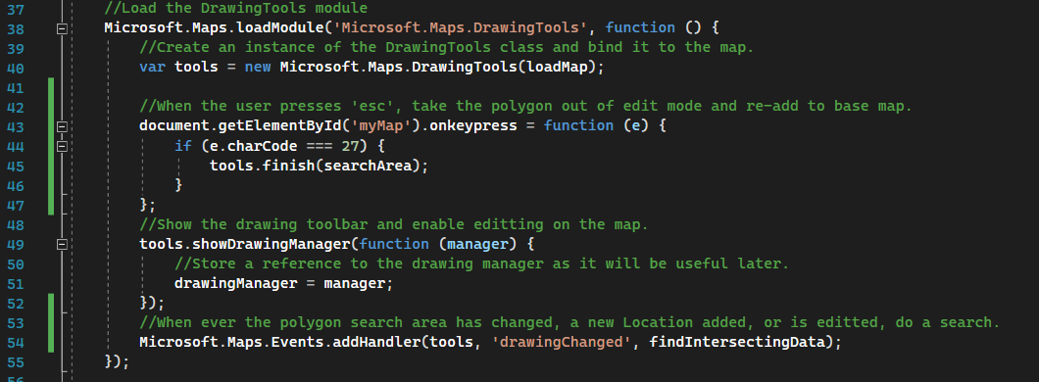


Another One

Slide 7


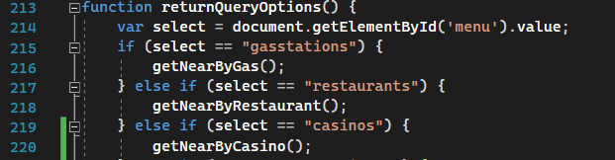
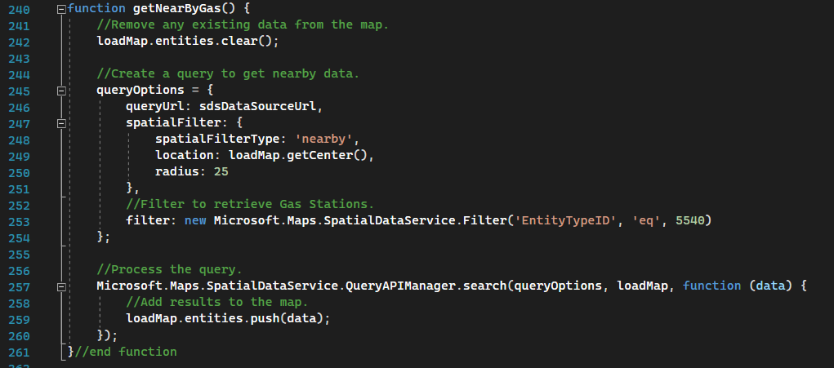
POI

Slide 8

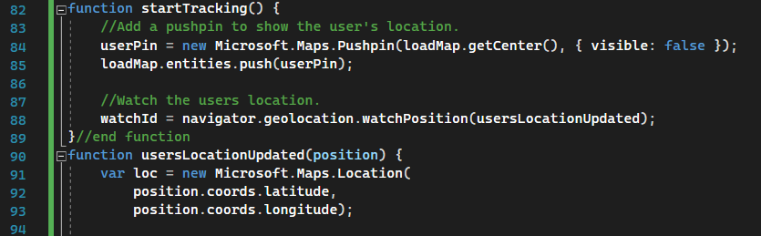
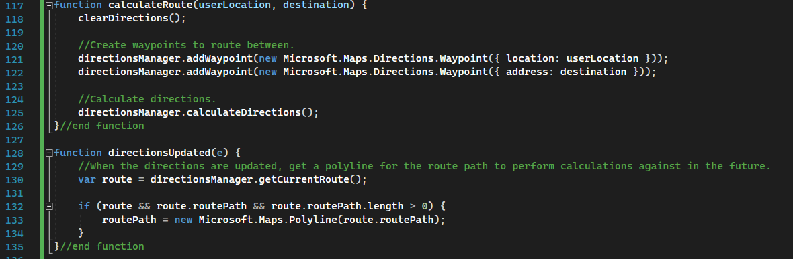
Directions

Slide 9





Closing Thoughts
Overall interesting project because of new experience
Very frustrating with Microsoft Documentation

